Slide 1
50.003: Elements of Software Construction
Week 8
Composing Thread-safe Objects

Slide 2
Objects which are accessed concurrently must be thread-safe.
How do we systematically build complicated thread-safe data structures?

Slide 3
Plan of the Week
Designing a thread-safe class
Instance confinement
Delegating thread safety
Adding functionality to thread-safe classes
Documenting synchronization policies

Slide 4
Design a Thread-Safe Class
The design process for a thread-safe class should include these three basic elements:
Identify the variables that form the object’s state;
Identify the requirements (e.g., invariants, post-conditions) that constrain the state variables;
Establish a policy for managing concurrent access to the objects state.

Slide 5
Step 1: Identifying States
An object’s state includes all of its mutable variables
If they are all of primitive type, the fields comprise the entire state.
If the object has fields that are references to other objects, its state will encompass fields from those as well.
Example: MyStack.java

Slide 6
Tips
The smaller this state space, the easier it is to reason about.
Use “final” as long as you can.
public class MyStack {
private final int maxSize;
private long[] stackArray;
private int top;
…
}

Slide 7
Step 2: Identifying Requirements
You cannot ensure thread safety without understanding an object’s specification. Constraints on the valid values or state transitions for state variables can create atomicity and encapsulation requirements.
Example: MyStack.java

Slide 8
Step 3: Establishing Policy
Guard each mutable state variable with one lock. Make it clear which lock.
Add waiting (and notify) to handle pre-conditions.
Example: MyStackThreadSafe.java

Slide 9
Cohort Exercise 1 (5 min)
Similarly identify the pre-condition/post-condition of other methods in MyStack.java and make the class thread-safe.

Slide 10
The above method works based on the assumption that the only way to access the state in the class is through calls of visible methods.

Slide 11
Instance Confinement
Composing Thread-safe Objects

Slide 12
Encapsulating Data
What is the problem?
public class MyStack {
private final int maxSize;
private long[] stackArray;
public int top;
//top < stackArray.length && top >= -1
…
}

Slide 13
Encapsulating Data
Identify the intended scope of objects
To a class instance (e.g., a private data field)
To a lexical scope (e.g., a local variable)
To a thread (e.g., an object which is not supposed to be shared across threads)
Instance confinement is one of the easiest ways to build thread-safe classes

Slide 14
Encapsulating Data
Make sure the objects don’t escape their scope
Bad Example 1:
public class MyStack {
private final int maxSize;
public long[] stackArray;
private int top;
//top < stackArray.length && top >= -1
…
}

Slide 15
Encapsulating Data
Make sure the objects don’t escape their scope
Bad Example 2:
public class MyClass {
//guard by “this”
private String[] states = new String[]{…};
private int size = states.length;
public synchronized String[] getStates() {
return states;
}
}
Example: PersonSet.java

Slide 16
Cohort Exercise 2 (20 min)
Assume a taxi tracking system which tracks taxis in Singapore. The updater threads would modify taxi locations and the view thread would fetch the locations of the taxis and display them. Examine Tracker.java (shared by the updater thread and the view thread) and make it thread-safe. Hint: make copy of a data structure to ensure instance confinement.
Example: TrackerFixed.java

Slide 17
Delegating Thread safety
Patterns for Composing Thread-safe objects

Slide 18
Delegating Thread Safety
Building thread-safe classes from thread-safe classes
Example (from Week 6):
public class FirstFixWithAtomicInteger {
public static AtomicInteger count = new AtomicInteger(0);
…
}
This works because the state of the class is count!

Slide 19
Cohort Exercise 3 (10 min)
Continue cohort exercise 2. Examine the modified class DelegatingTracker.java and discuss whether it is thread safe or not.
Example: DelegatingTracker.java

Slide 20
Publishing State Variables
When is it safe to publish state variables?
If a state variable is thread-safe, does not participate in any invariant that constrain its value, and has no prohibited state transitions for any of its operations, then it can be safely published.
It still might not be a good idea, since publishing mutable variables constrains future development and opportunities for sub-classing.

Slide 21
Example: PublishingTracker.java
Assuming that there is no additional constraints on vehicle locations, other than that they must be this given pair.
PublishingTracker delegates its thread-safety to ConcurrentHashMap and Point.

Slide 22
Delegating Thread Safety
If a class is composed to multiple independent thread-safe state variables, then it can delegate thread safety to the underlying state variables.
If a class has invariants the relate its state variables, then delegation may not work.

Slide 23
Cohort Exercise 4 (10 min)
Modify Range.java so that it is thread-safe.
Example: RangeSafe.java

Slide 24
Adding functionality to thread-safe classes
Composing Thread-safe Objects

Slide 25
Motivation
How to extend a thread-safe class with new operations?
Method 1: modifying the class
Method 2: extending the class
Method 3: client-side locking
Method 4: composition

Slide 26
Modifying the Class
If you have the source code, apply the knowledge that you acquired previously to add the required method in the class.
Example: MyList.java

Slide 27
Extending the Class
Sometimes a thread-safe class (e.g., a class from java.util.concurrent) supports almost all the operations we want.
Which lock is it using?
Example 2: if you don’t have the source code,
Example: BetterVector.java

Slide 28
Private Lock
Instead of guarding state variables by locking “this”, private locks can be used too.
Example:
public class PrivateLock {
private final Object myLock = new Object();
//@GuardedBy(“myLock”)
Widget widget;
void someMethod() {
synchronized(myLock) {
//Access or modify the state of widget
}
}
}
Private Locks are flexible and risky.

Slide 29
Extending the class
More fragile than adding code directly to a class, because the implementation of the synchronization policy is now distributed over multiple, separately maintained source files.
Example: ExtendedPair.java and ExtendedPairWrong.java

Slide 30
Client-side Locking
Example: Add a method addIfAbsent to Collections.synchronizedList
We don’t have the source code or enough access to the internal state so that we can extend the class.
Client-side locking entails guarding client code that uses some object X with the lock X uses to guard its own state.
public class ListHelper<E> {
public java.util.List<E> list =
Collections.synchronizedList(new ArrayList<E>());
}

Slide 31
Question
Is this thread safe?
public class ListHelper<E> {
public java.util.List<E> list =
Collections.synchronizedList(new ArrayList<E>());
public synchronized boolean putIfAbsent(E x) {
boolean absent = !list.contains(x);
if (absent) {
list.add(x);
}
return absent;
}
}
Example: ListHelper.java

Slide 32
Cohort Exercise 5 (10 min)
Assume that multiple threads may call the static methods defined in FirstExample.java, fix FirstExample for potential problems.
Hint: In Javadoc, it is documented that the synchronized collections commits to certain synchronization policy

Slide 33
Hint
public static Object getLast(Vector list) {
int lastIndex = list.size() - 1;
return list.get(lastIndex);
}
public static void deleteLast(Vector list) {
int lastIndex = list.size() - 1;
list.remove(lastIndex);
}
Thread A
size:10
get(9)
Thread B
size:10
remove(9)

Slide 34
Client-Side Locking
Even more fragile than extending the class because it distributes the locking code for a class into classes that are totally unrelated to the class.
Modifying the class: keeps the locking code in the same class
Extending the class: distributes the locking code in the class hierarchy

Slide 35
Composition
It is less fragile if list is accessed only through improvedList.
It doesn’t care whether list is thread-safe or not.
It adds performance penalty due to the extra layer of synchronization.
Example: ImprovedList.java

Slide 36
Cohort Exercise 6 (15 min)
Write a thread-safe class named SafeStack which extends java.util.Stack<E> with two operations pushIfNotFull(E e) and popIfNotEmpty(). Do it in different ways and design an experiment to compare the performance of the two.
Click here for a sample program: SafeStack.java

Slide 37
Documenting synchronization policies
Patterns for Composing Thread-safe objects

Slide 38
Documenting
Documentation is one of the most powerful tools for managing thread safety.
Document a class’s thread safety guarantees for its clients; document its synchronization policy for its maintainers.
Is thread-safety documented in JDK?

Slide 39
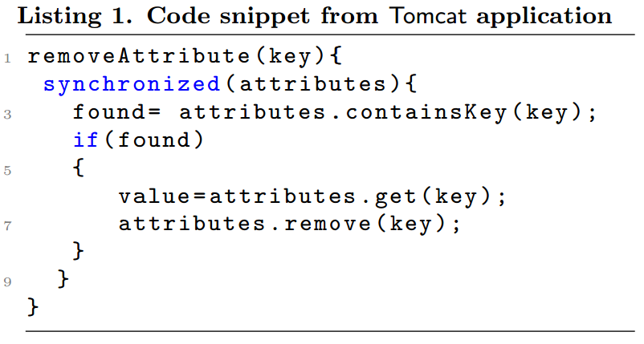
One Case
Tomcat Bug: 53498
https://bz.apache.org/bugzilla/show_bug.cgi?id=53498
The fix
Any problem?

Slide 40
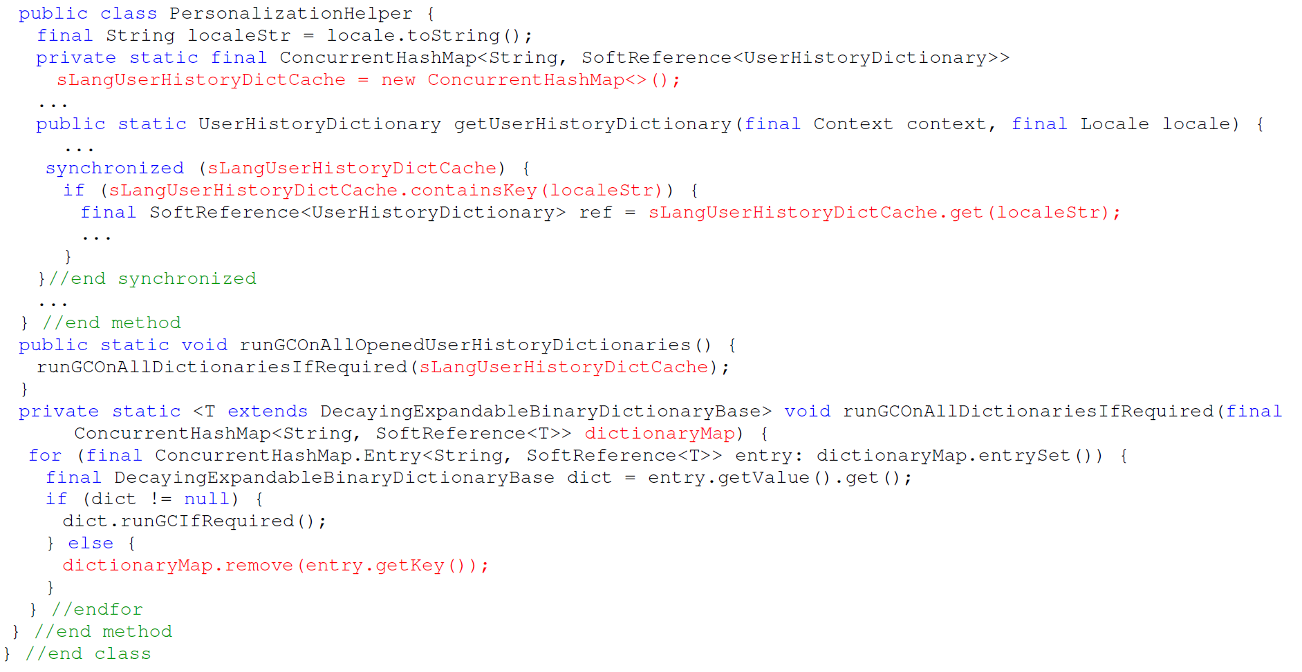
Another Case

